Slide 1
Dt. 31/01/2026 Exploratory Data Analysis (EDA) for Real Estate Pricing:
Analysing property trends through comprehensive data exploration
NextHikes IT Solutions
Sarita Sahoo
Notes:
AI-generated content may be incorrect. ---

Slide 2
Agenda Highlights
Introduction to Exploratory Data Analysis in Real Estate
Data Preparation and Cleaning
Univariate, Bivariate and Multivariate Analysis
Key Insights and Implications for Pricing Models
Notes:
Introduction to Exploratory Data Analysis in Real Estate Data Preparation and Cleaning Univariate and Multivariate Analysis Geospatial and Temporal Patterns Key Insights and Implications for Pricing Models

Slide 3
Introduction to Exploratory Data Analysis in Real Estate
Notes:
Purpose and Importance of EDA in Real Estate Pricing, Common Challenges in Real Estate Data, Overview of Property Data Sources

Slide 4

Purpose and Importance of EDA in Real Estate
Understanding Data Structure
EDA helps analysts grasp the core structure of real estate data to identify key patterns and anomalies early.
Revealing Market Trends
Through EDA, trends in market conditions, property features, and buyer behaviors are uncovered for better pricing models.
Ensuring Data Quality
EDA improves data quality and reduces bias by selecting meaningful features essential for accurate price prediction.
Common Challenges in Real Estate Data Pricing
Data Quality Issues
Real estate datasets often have missing or inconsistent property details and transaction records that affect analysis quality.
Price Outliers
Luxury and distressed property sales create price outliers that complicate real estate market analysis.
Data Integration Challenges
Heterogeneous property types and multiple data sources cause difficulties integrating real estate datasets effectively.
Seasonality and Market Changes
Seasonal trends and market shifts add complexity, requiring advanced preprocessing to maintain data accuracy.
Notes:
--- Exploratory Data Analysis (EDA) is crucial in real estate pricing as it enables analysts to understand the underlying data structure, spotting patterns and anomalies before modeling. EDA helps reveal trends in market conditions, property attributes, and buyer preferences, which are essential for accurate price estimations. It reduces the risk of model bias by ensuring data quality and selecting meaningful features for prediction. Image source: AI-generated

Slide 5

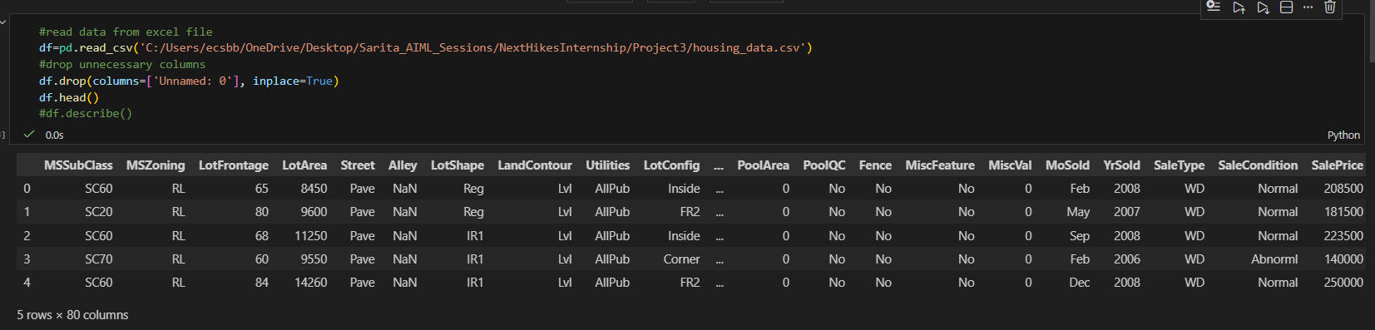
EDA for Real Estate Pricing: Problem Statement
Feature Engineering and Size Impact:
● Engineer new features capturing relevant information such as price per square foot or the age of the property.
● Visualize the relationship between key features like bedrooms, bathrooms, and square footage with house prices, determining their impact on valuation.
Market Trends and Historical Pricing:
● Analyze historical pricing trends over time, considering external factors like economic indicators.
● Create time-series visualizations to understand how market trends influence house prices, helping predict future valuation trends.
“Housing Data.csv” dataset provided to analyse.
Notes:
--- Real estate datasets often contain missing or inconsistent data, such as incomplete property details or irregular transaction records. Price outliers can arise from luxury properties or distressed sales, complicating analysis. Additionally, heterogeneity in property types and data sources can cause integration difficulties. Seasonality and market changes add further complexity, requiring robust data preprocessing techniques. Image source: AI-generated

Slide 6
Data Preparation and Cleaning
Notes:
Identifying and Handling Missing Values, Dealing with Outliers in Property Prices, Feature Engineering for Real Estate Data

Slide 7
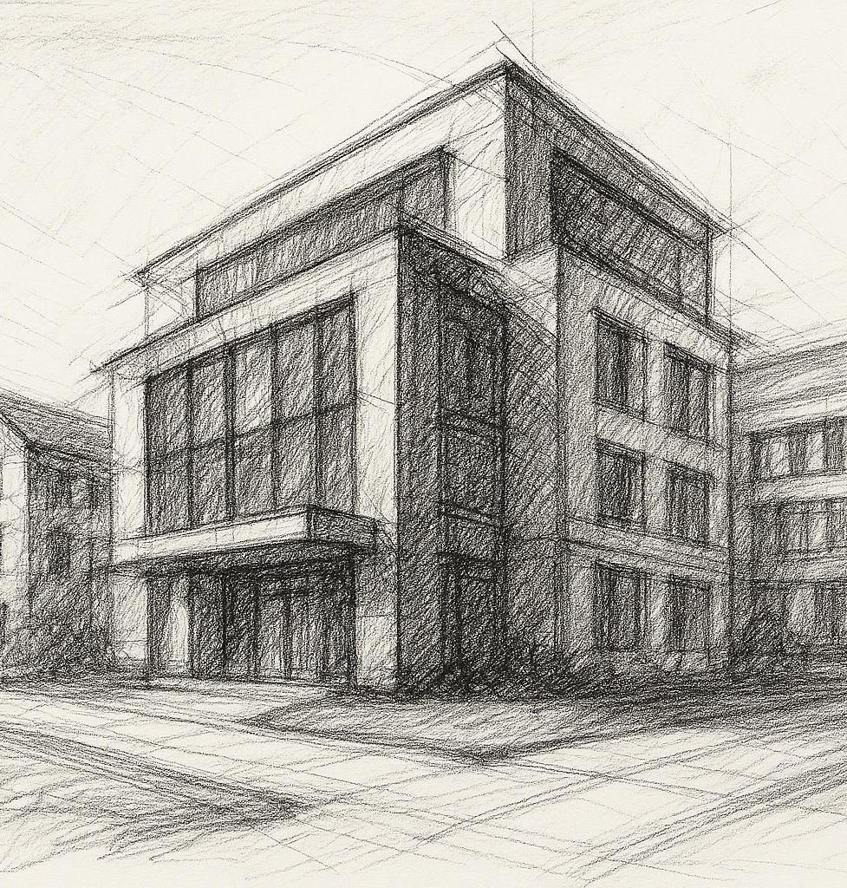
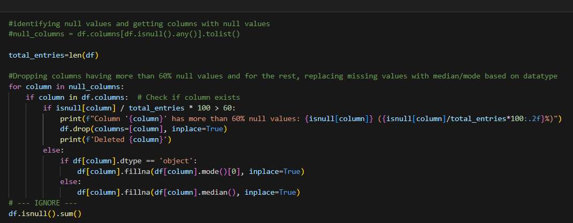
Identifying and Handling Missing Values
Patterns of Missingness
Identifying whether missing data is present in the dataset and is crucial for unbiased analysis.
Imputation Techniques
Common imputation methods include median price substitution.
Visualization for Cleaning
Mapping missing data visually helps detect trends and ensures cleaning maintains dataset integrity.
Notes:
--- Missing data can bias real estate analyses; hence, identifying patterns of missingness—random or systematic—is key. Common techniques include imputation using median prices, k-nearest neighbors, or domain-specific assumptions. Visualization of missing data maps helps detect underlying trends, ensuring appropriate cleaning that maintains dataset integrity without distorting price distributions. Image source: AI-generated

Slide 8

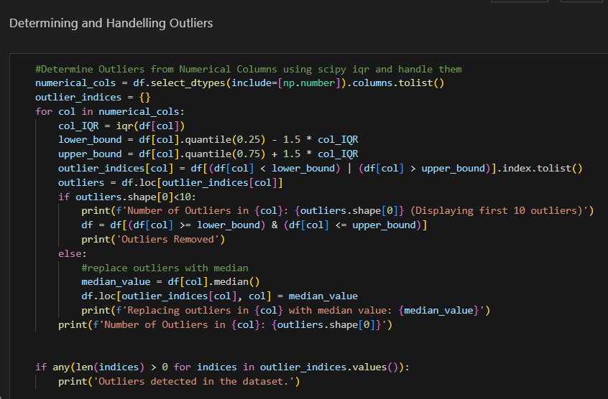
Dealing with Outliers in Property Prices
Impact of Outliers
Outliers like luxury estates and foreclosures can distort pricing models and affect predictions adversely.
Statistical Filtering Methods
Used IQR clipping technique to help identify and remove outliers effectively.
Transformation
Tried log transformation to reduce outlier impact, enhancing model stability and interpretability.
Notes:
--- Outliers such as ultra-luxurious estates or undervalued foreclosures can skew pricing models. Statistical methods include Z-score filtering, IQR range clipping, and domain-specific thresholding. Robust regression techniques and transformation (e.g., log transformation) further mitigate outlier effects, preserving model stability and interpretability. Image source: AI-generated

Slide 9

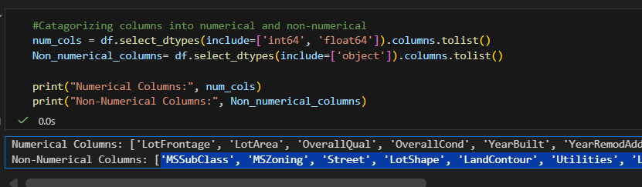
Feature Engineering for Real Estate Data
Key Numerical Features
Numerical features like price per square foot and property age (LotArea, OverallQual, YearBuilt, YearRemodAdd, TotalBsmtSF, GrLivArea, BsmtFullBath, BsmtHalfBath, GarageCars, GarageArea, MiscVal, SalePrice) enhance predictive accuracy of real estate models.
Categorical Features
Key Categorical features like MSZoning, LotShape, Utilities, Neighborhood, HouseStyle, MiscFeature, Sale Type enhance predictive accuracy of real estate models.
Socioeconomic Factors
Proximity to amenities and neighborhood socioeconomic indices provide critical context for property valuation.
Notes:
--- Creating meaningful features enhances model predictive power. Examples include price per square foot, proximity to amenities, age of the property, and neighborhood socioeconomic indices. Temporal features like days on market or sales velocity also inform price trends. Feature interactions and dummy variables for categorical attributes improve capturing complex market dynamics. Image source: AI-generated

Slide 10
Univariate, Bivariate and Multivariate Analysis
Notes:
Analyzing Key Variables (Price, Size, Location), Visualizing Distributions and Trends, Correlations Between Features and Pricing

Slide 11

Analysing Key Variables (Price, Size, Location)
Price Distribution Patterns
Property prices are right-skewed due to the influence of high-end listings in the market.
Correlation Between Size and Price
Property size generally correlates with Sale price but shows variations.
Impact of Location on Value
Location influences property value through accessibility, neighborhood quality.
Use of Statistical Summaries
Statistical summaries and boxplots help identify typical versus a typical property characteristics by showing data spread.
Univariate Analysis
Numerical columns exhibit varying degrees of skewness, with some being positively skewed, indicating a longer tail on the right side of the distribution.
Several numerical columns contain outliers, which may impact statistical analysis and model performance.
Categorical columns show diverse distributions, with some categories being more prevalent than others, suggesting potential class imbalances.
The skewness and kurtosis values provide insights into the shape of the distributions, which can inform data transformation strategies.
Categorical data distributions highlight the need for careful consideration of class representation in modeling tasks.
Overall, the dataset exhibits a mix of numerical and categorical features, each requiring tailored analysis approaches.
EDA should consider these insights for effective data preprocessing and modeling strategies.
Further analysis may be needed to explore relationships between variables and their impact on target outcomes.
Notes:
--- Price distributions typically exhibit right skewness, influenced by high-end listings. Property size correlates strongly with price but varies regionally. Location drives value via accessibility, neighborhood quality, and school district ratings. Statistical summaries and boxplots clarify central tendency and spread, identifying typical versus atypical property characteristics. Image source: AI-generated

Slide 12

Visualization Pattern:
Numerical Columns: Histogram (for distribution) & Boxplot (for outliers)
Categorical Columns: Bar Plot
Overall Summary:
For Numerical Columns-
1. low skewness, low kurtosis, and few outliers : LotFrontage, OverallQual, FullBath, BedroomAbvGr, GarageCars, GarageArea. These demonstates symmtric districbution, so less processing required
2. Moderately Skewed Features (Noticiable yet managible) : OverallCond, YearBuilt, YearRemodAdd, BsmtUnfSF, 2ndFlrSF, BsmtFullBath, HalfBath, TotRmsAbvGrd, Fireplaces, GarageYrBlt
3. High skewness, very high kurtosis, and many outliers : LotArea, MasVnrArea, BsmtFinSF1, BsmtFinSF2, TotalBsmtSF, 1stFlrSF, LowQualFinSF, GrLivArea, BsmtHalfBath, KitchenAbvGr, WoodDeckSF, OpenPorchSF, EnclosedPorch, 3SsnPorch, ScreenPorch, PoolArea, MiscVal, SalePrice. These needs to be treated to achieve linear model.
Housing prices are primarily driven by living area, quality, and zoning/subclass effects
Most outliers occur in size and amenity-based features such as lot size, basement areas, porches, pools, misc. values
These represent meaningful market behavior rather than data errors so handled through transformation rather than removal.
For non-Numerical/ Object columns-
Majority of columns are imbalanced due to dominant majority of category falling under the columns.
e.g. MSZoning with a dominant majority Residential Low Density (RL) zoning. It implies-
Homes in RL zones likely command higher and more stable prices due to larger lot sizes and lower density, while RM, RH, and C zones may exhibit different pricing dynamics driven by density and mixed-use constraints.
LotShape provides meaningful geometric information about the property. While regular lots dominate the dataset, varying degrees of irregularity can influence price and should be retained as an ordered categorical feature, with careful handling of rare extreme categories.
The dataset is dominated by a few residential neighborhoods, while many areas are sparsely represented, requiring careful encoding and potential grouping for robust modeling.
Notes:
--- Density plots and kernel smoothing reveal the distribution of pricing and size variables, highlighting multi-modality or skewness. Time series plots demonstrate seasonal price cycles and market shifts. Visualization aids in detecting exceptions and ongoing trends that may influence valuation strategies. Image source: AI-generated

Slide 13
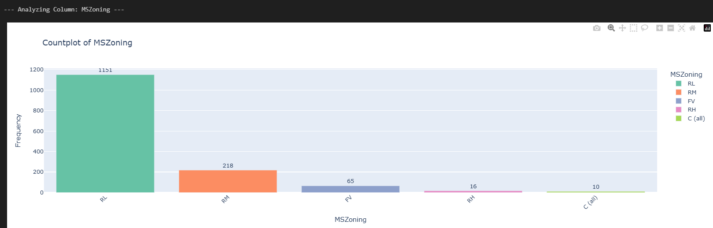
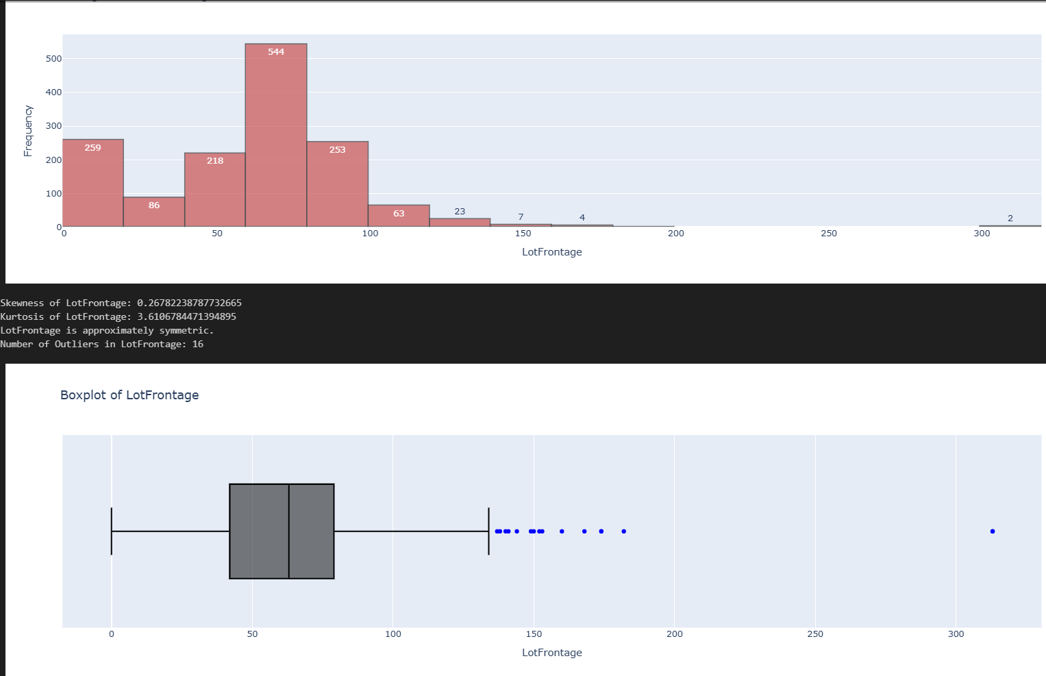
Sample Representation:
Categorical Data:
Numerical Data:
Notes:
--- Density plots and kernel smoothing reveal the distribution of pricing and size variables, highlighting multi-modality or skewness. Time series plots demonstrate seasonal price cycles and market shifts. Visualization aids in detecting exceptions and ongoing trends that may influence valuation strategies. Image source: AI-generated

Slide 14

Bivariate Analysis (Against Target Column “SalesPrice“)
Visualization Pattern:
Numerical Columns: Scatter Plot with regression line
Categorical Columns: Box Plot
Overall Summary: (On Few of the Impacting columns)
Sale prices vary significantly across zoning categories, with FV and RL showing the highest median prices, while commercial zoning exhibits consistently lower values, indicating that MSZoning is a strong categorical predictor of housing prices.
Sale prices differ significantly across MSSubClass categories, with newer and multi-story dwelling types commanding higher prices, while older or conversion-style homes consistently sell for less.
SalePrice increases with YearBuilt showing a moderate positive correlation, but the wide dispersion indicates that these alone are insufficient to explain price without considering quality and other features.
OverallQual,Living area,GarageArea,GarageCars show a strong linear relationship with sale price, explaining a substantial portion of price variability. However, increasing variance at higher areas suggests the influence of additional quality and location factors.
Notes:
--- Key data sources include multiple listing services (MLS), public property tax records, real estate portals, and government census data. Emerging data streams like satellite imagery and social media insights complement traditional sources by providing geospatial and sentiment information. Integrating diverse sources enriches data granularity but demands reconciliation of format and update frequency. Image source: AI-generated

Slide 15
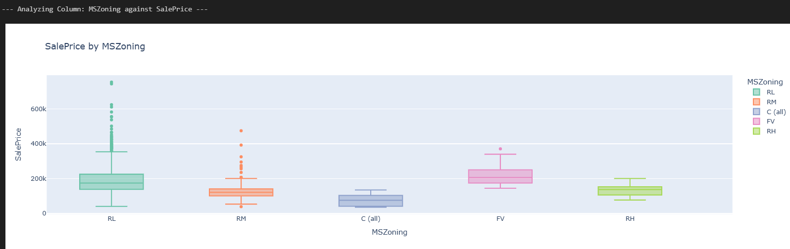
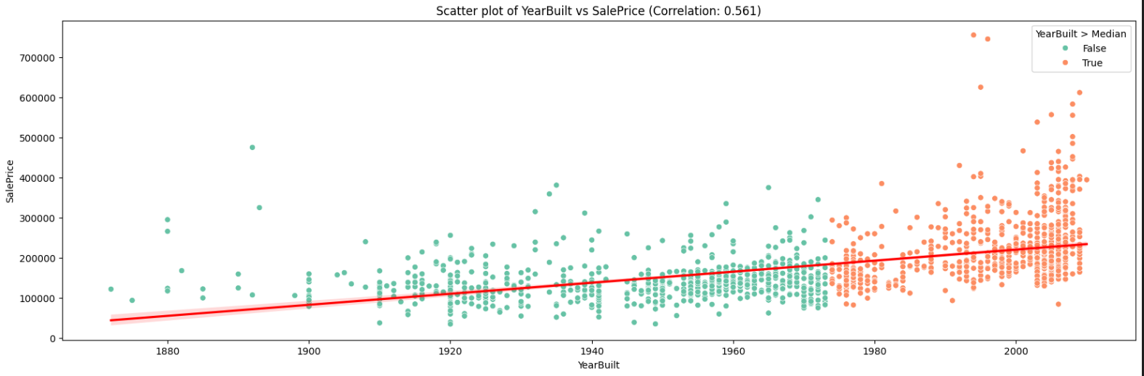
Sample Representation:
Categorical Data:
Numerical Data:

Slide 16
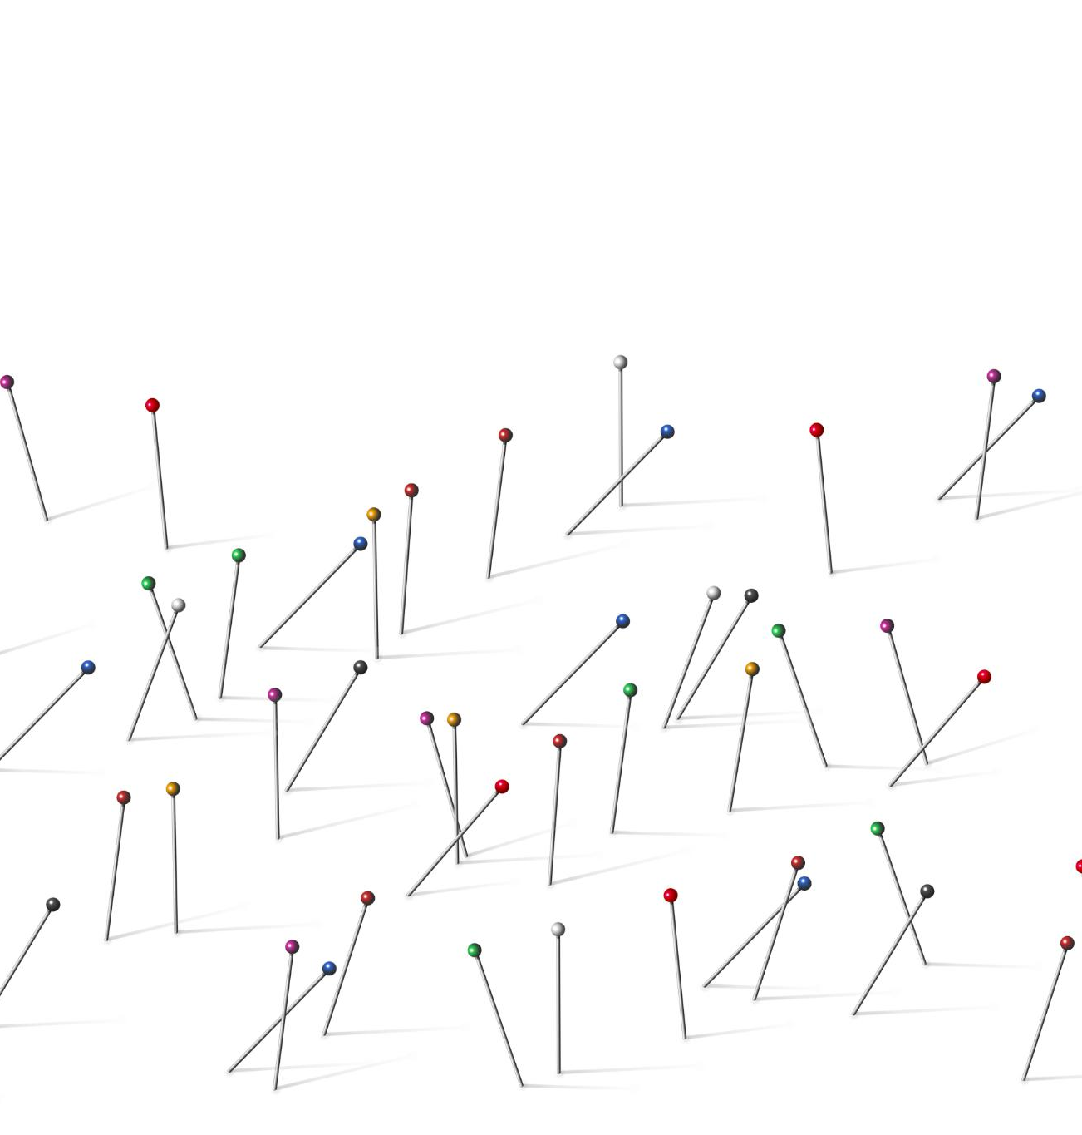
BIVARIATE ANALYSIS - JOINT PLOT
Combined Visualizations
Joint plots integrate scatterplots and histograms, allowing simultaneous exploration of correlation and distribution.
Pattern and Outlier Detection
These plots help identify trends, patterns, and outliers, supporting effective data exploration and statistical analysis.
Overall Summary:
A log transform helps:
1. Linearize curved relationships
2. Reduce the impact of outliers
3.Stabilize variance
Slope is equivalant to elasticity. It signifies 1% increase in the logged columns → ~<slope>% increase in SalePrice
If slope were:
≈ 1 → almost proportional pricing (e.g. GrLivArea,Garage Car space. These are strong and consistent predictors of SalePrice)
> 1 → luxury amplification effect (e.g. Overall Quality has an amplifying effect on sale price. This suggests premium valuation behavior rather than simple proportional pricing.)
< 0.5 → weak or secondary feature (e.g. Total Basement that rarely influence price)
The extremely large elasticity/slope of YearBuilt indicates instability caused by feature scaling rather than a genuine economic effect, which implies Year Built is misleading feature for log transformation and can be ignored
While a linear relationship dominates, the presence of outliers and increasing price variance with size suggests the need for transformation or robust modeling techniques.
Notes:
Image source: Microsoft 365 content library Bivariate analysis investigates the relationship between two variables, and joint plots visually display their interactions. Joint plots combine scatterplots with histograms, showing both the correlation and distribution of each variable. They help identify patterns, trends, and outliers, making them useful for data exploration and preliminary statistical analysis.

Slide 17
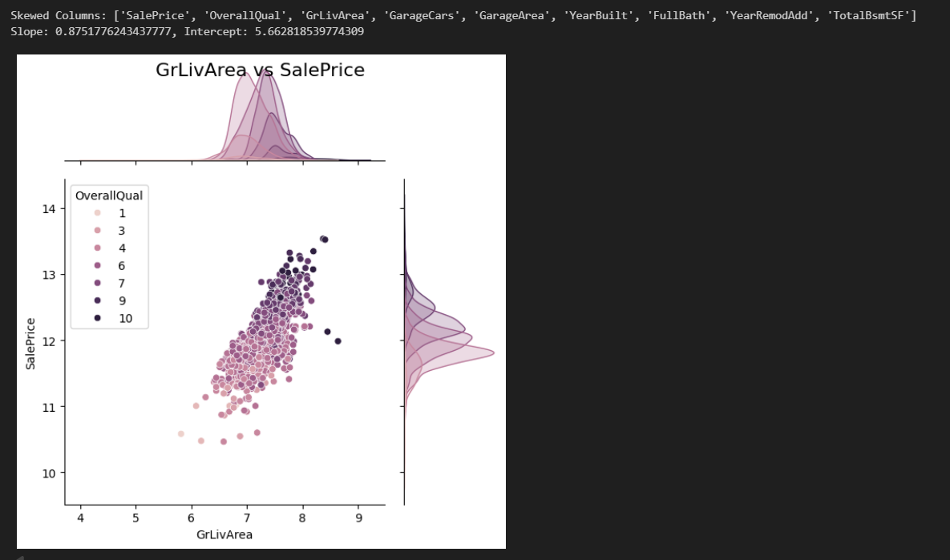
Sample Representation

Slide 18

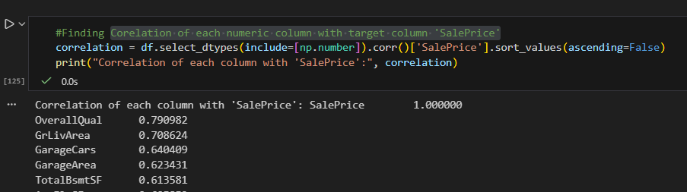
Correlations Between Features and Pricing
Correlation Matrix interpretation
It ranges from -1 to +1.
A value close to +1 indicates a strong positive correlation, meaning as one variable increases, the other tends to increase as well.
A value close to -1 indicates a strong negative correlation, meaning as one variable increases, the other tends to decrease.
A value close to 0 indicates little to no linear correlation between the variables.
Feature-Price Relationships
Correlation matrices reveal strong positive links between price and features like square footage and location desirability.
Weak and Negative Correlations
Some features, such as property age, show weak or negative correlations with pricing in various markets.
Notes:
--- Correlation matrices and heatmaps expose relationships between size, location indices, amenities, and price. Strong positive correlations with square footage and location desirability contrast with weak or negative correlations with property age in some markets. Identifying multicollinearity helps refine predictive models and feature selection. Image source: AI-generated

Slide 19
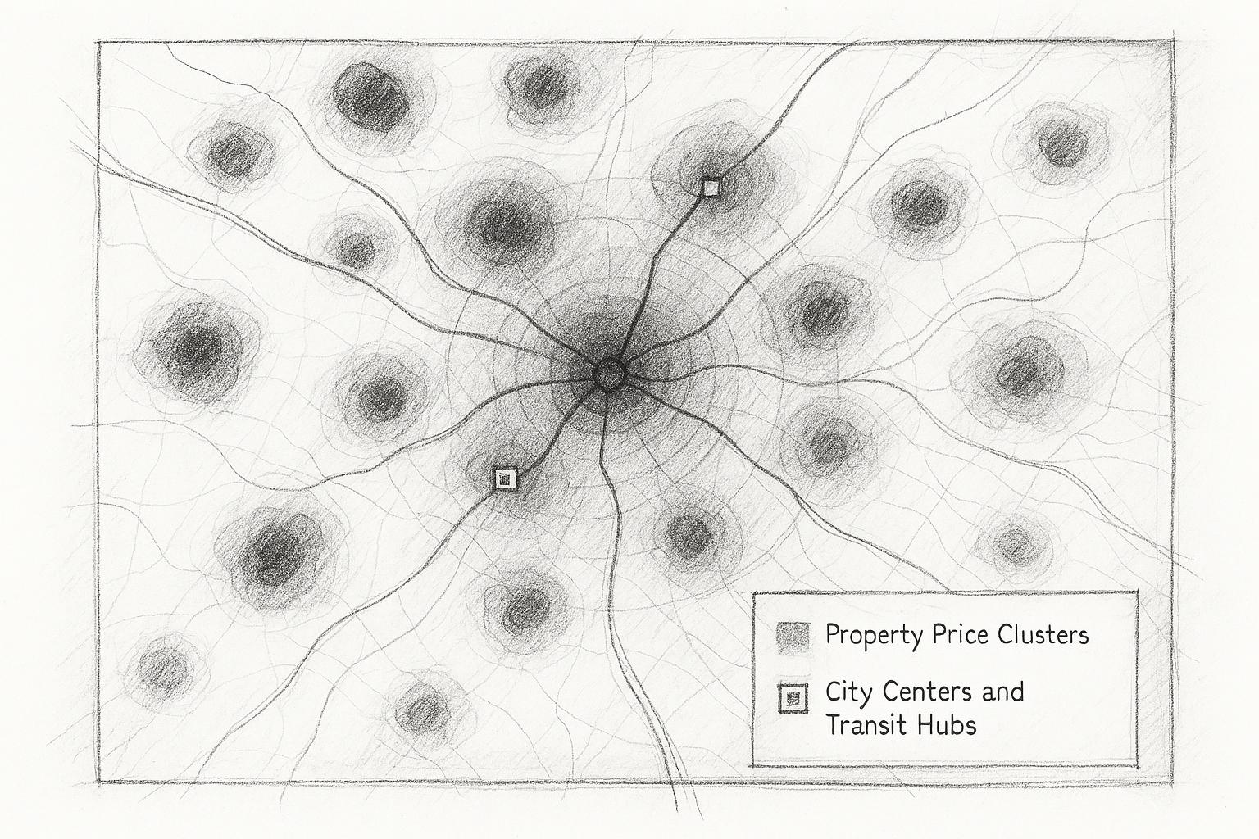
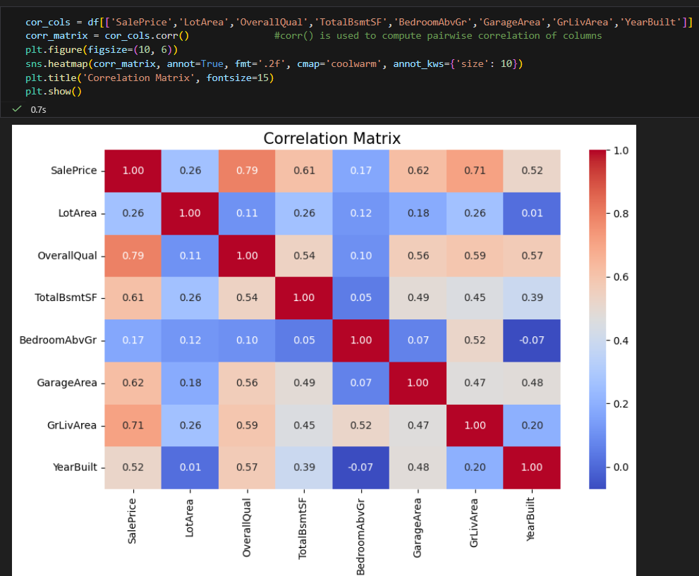
Mapping Property Prices Geographically
Heatmaps for Price Visualization
Heatmaps display average prices or price per square foot to show spatial price variations effectively.
Overall Summary:
More or less all the features has positive co-relation or impact on SalesPrice except YearSold, MiscVal (Value of Miscellaneous feature installed)
Notes:
--- Geospatial analysis uncovers price clusters, identifying prime real estate zones and undervalued neighborhoods. Heatmaps reflecting average prices or price per square foot elucidate spatial disparities. Integration with GIS data enables understanding proximity effects to city centers, parks, or transit hubs, informing price relativities. Image source: AI-generated

Slide 20
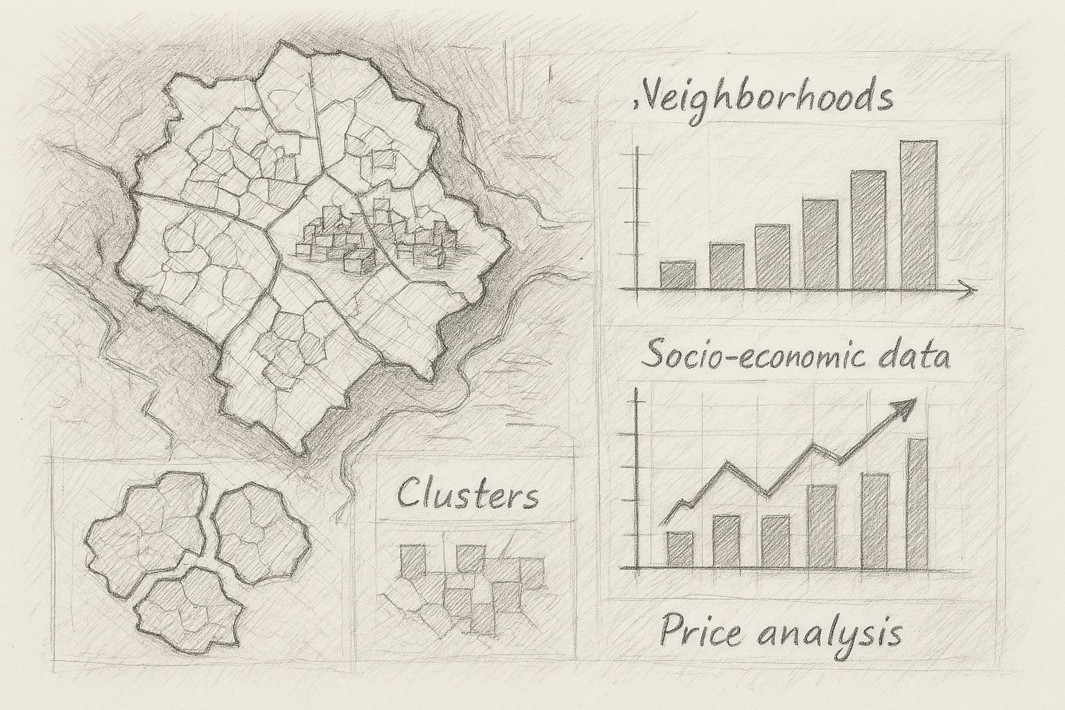
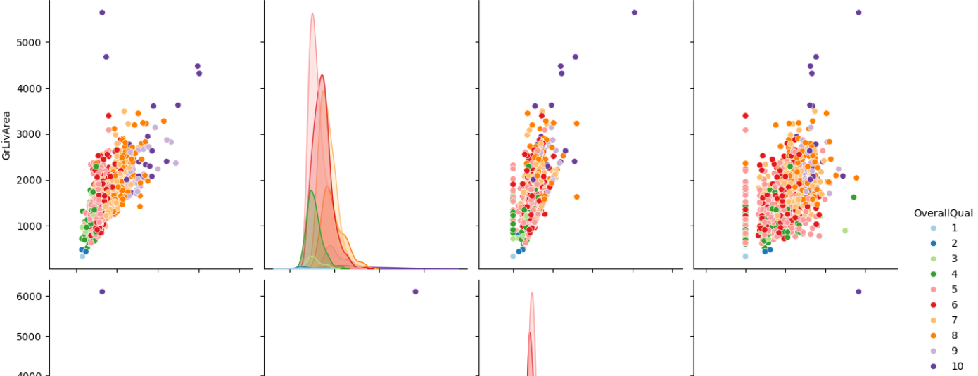
MULTIVARIATE ANALYSIS – PAIR PLOT
Pair plot designed on SalePrice, OverallQual, GrLivArea, TotalBsmtSF, GarageArea, YearBuilt columns to analyse their impact on each-other as well as Salese.
,
Overall Summary:
The pair plot reveals strong positive relationships between GrLivArea, GarageArea, and SalePrice. Clear segmentation by OverallQual is visible, with higher quality homes consistently commanding higher prices across all size-related features. The distribution of SalePrice is right-skewed, indicating the presence of high-value outliers.
Price increases consistently with property size, while quality strongly amplifies valuation, making these features critical for predictive modeling.
Notes:
--- Regional analysis highlights socio-economic factors driving price heterogeneity. Neighborhood clustering techniques classify areas by price behavior, amenities, and demographic profiles. Comparative analysis between regions informs investment decisions and localized pricing strategies. Image source: AI-generated

Slide 21
Key Insights and Implications for Pricing Models
Notes:
Summary of EDA Findings, Impacts on Predictive Modeling and Valuation, Recommendations for Stakeholders

Slide 22
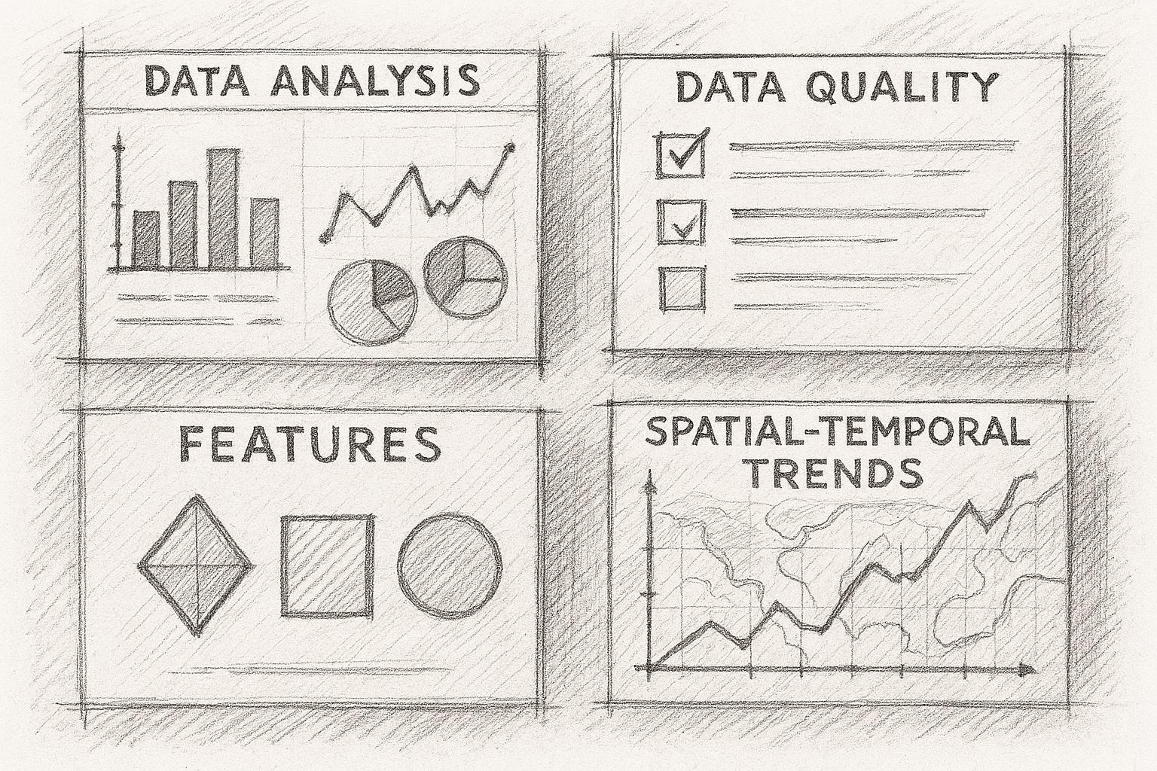
Summary of EDA Findings
Market Drivers Identified
EDA highlights key market drivers including location, size, etc…
More or less all the features has positive co-relation or impact on SalesPrice except YearSold, MiscVal (Value of Miscellaneous feature installed)
Data Quality Challenges
Addressing missing values and outliers is crucial before model development to ensure data integrity.
Feature Engineering Insights
Feature engineering and correlation analysis enhance model robustness and interpretability for pricing. Price increases consistently with property size, while quality strongly amplifies valuation, making these features critical for predictive modeling.
Notes:
--- Comprehensive EDA reveals critical market drivers such as location, size, and temporal trends. Data quality issues like missing values and outliers must be addressed pre-modeling. Feature engineering and correlations inform more robust, interpretable pricing models. Spatial and temporal analyses provide rich contextual insights. Image source: AI-generated

Slide 23

References
https://www.datacamp.com/blog/data-preprocessing
https://seaborn.pydata.org/generated/seaborn.jointplot.html
https://www.theclickreader.com/univariate-bivariate-and-multivariate-analysis/
https://matplotlib.org/stable/users/explain/colors/colormaps.html

Slide 24
Conclusion: Harnessing EDA to Drive Smarter Real Estate Pricing Decisions
Unveiling Data Patterns
EDA helps identify trends and patterns in property data that are critical for pricing strategies.
Enhancing Predictive Models
Insights from EDA improve the accuracy of predictive models for property price forecasting.
Supporting Informed Decisions
EDA enables buyers, sellers, and analysts to make data-driven and confident real estate decisions.
Notes:
In summary, Exploratory Data Analysis plays a crucial role in unveiling patterns, handling challenges, and extracting meaningful insights from property data. These insights enhance predictive models and support informed decision-making for various stakeholders in the real estate market. Embracing EDA ensures more accurate pricing and better understanding of market dynamics, ultimately benefiting buyers, sellers, and analysts alike.

